Slide 1
Lecture 2: Training neural networks
Practical deep learning

Slide 2
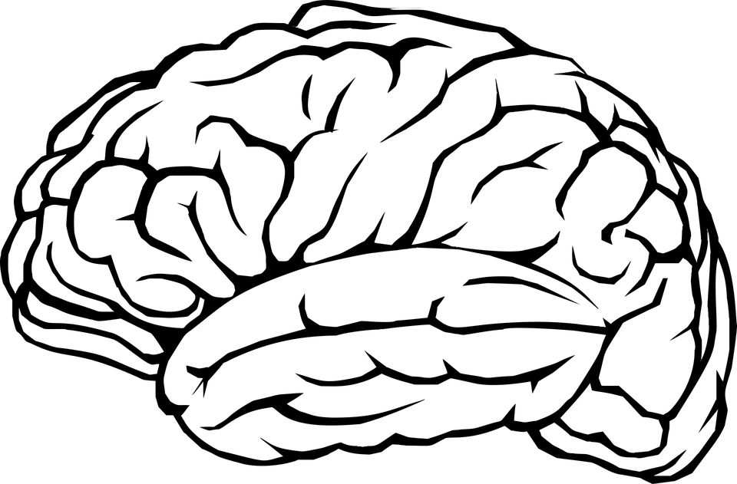

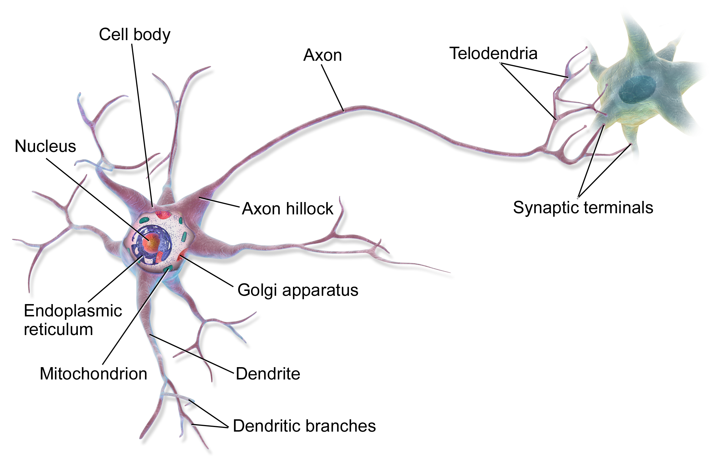
0,93
× 0,1
-0,1
× 0,8
0,42
× 0.5
+
× -0.4
0,23
× -0,3
-0,3
Biological neuron
Artificial neuron (perceptron)
Image source: https://commons.wikimedia.org/wiki/File:Blausen_0657_MultipolarNeuron.png

Slide 3
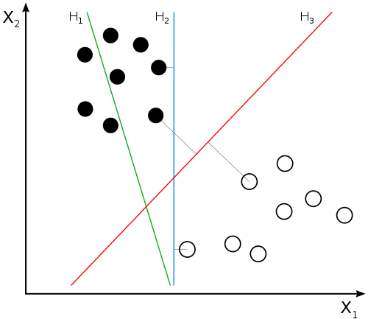
Neuron as a linear classifier
x₂
× w₂
+
× w₁
x₁
w₀
“bias” term
x₁w₁ + x₂w₂ + w₀ = 0
describes the separating line
By User:ZackWeinberg, based on PNG version by User:Cyc [CC BY-SA 3.0], via Wikimedia Commons

Slide 4
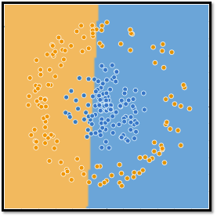
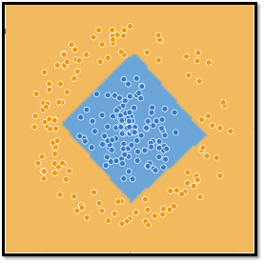
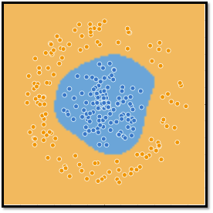
Not all problems are linear …

Slide 5





Activation function
+
Linear classifier - makes the class “decision” on the neuron’s output
In general:
Nonlinear
Differentiable (mostly)
Consider range of outputs: 0..1, -1..1, 0..∞
step
sigmoid
hyperbolic tangent
ReLU
softplus

Slide 6
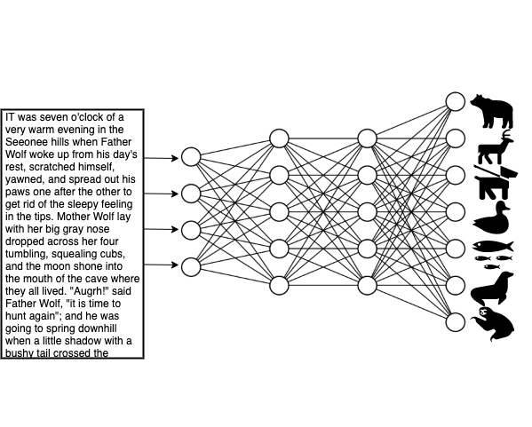
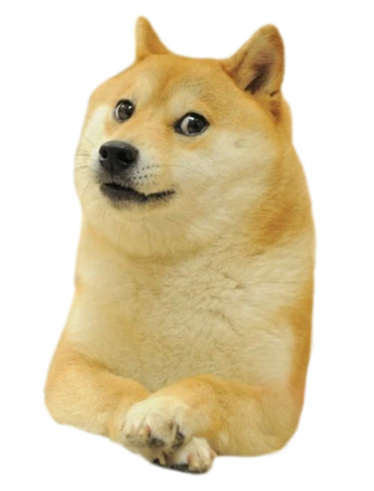
Feed-forward neural network
Output based on task to solve
Single neuron performs simple calculation
+
0,51
0,07
0,93
0,33
-0,1
0,02
0,42
0,01
0,23
0,01
Input must be numerical
Each connection weighted
0,05

Slide 7
Feed-forward neural network
Output layer
Hidden layers
Input layer
0,93
-0,1
0,42
0,23

Slide 8
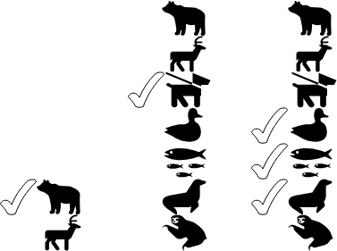

Output activation
Input
Usually a non-linear activation after each layer
Typically ReLU between the layers
At the output layer we need to consider the task, i.e., what kinds of outputs we want, e.g,
Multi-label classification each K output separate probability (values 0.0-1.0) → sigmoid
Multi-class classification probability distribution over K classes (sums to 1.0) → softmax
Regression free range of values → linear
Layer 1
ReLU
Layer 2
ReLU
Layer 3
e.g. softmax
softmax:
Output

Slide 9
Learning the weights
“Bear? It should be dog”
0,51
0,07
0,93
We need labeled data to be able to check for errors
0,33
-0,1
0,02
0,42
0,01
0,23
0,01
0,05

Slide 10
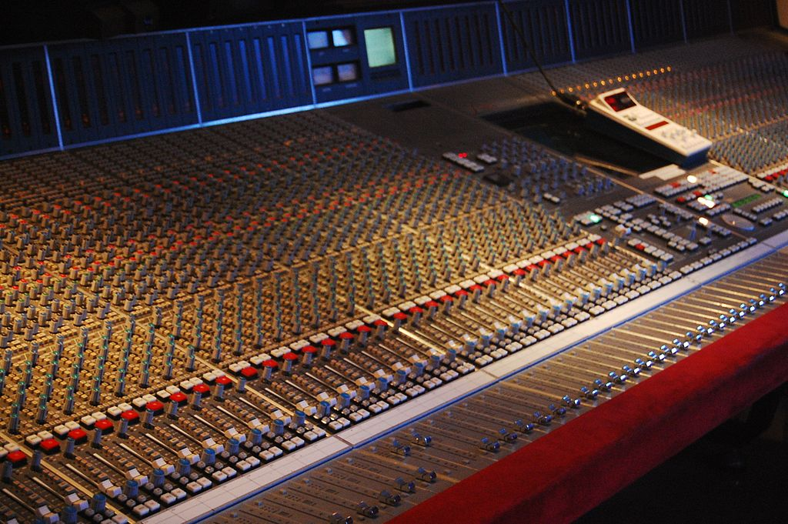
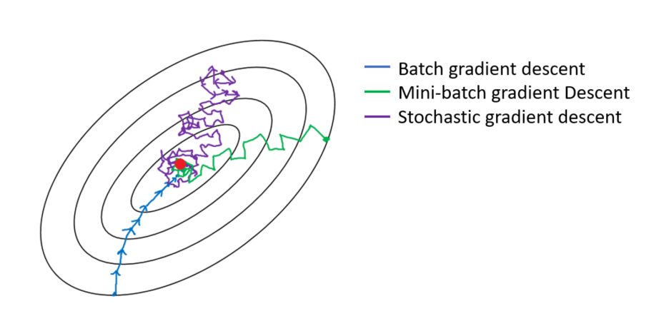
Learning the weights
By Rebecca Wilson (originally posted to Flickr as Vicariously) [CC BY 2.0], via Wikimedia Commons
Starting from random weights
Cost function or loss = difference between network output and correct output
Adjust weights to get closer to the correct answer
Gradient descent: find direction (in “weight space”) where loss decreases most
Stochastic gradient descent
Mini-batches
Image from: https://towardsdatascience.com/gradient-descent-algorithm-and-its-variants-10f652806a3

Slide 11
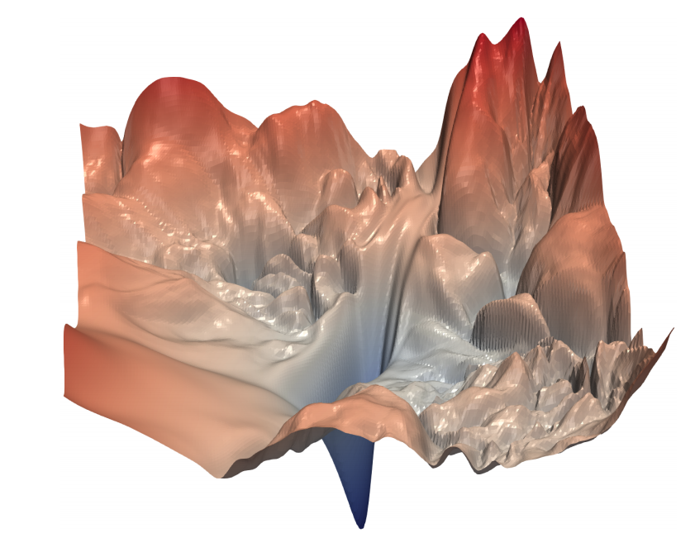
Finding the best weights not so easy...
Image from: Li et al. “Visualizing the Loss Landscape of Neural Nets”, arXiv:1712.09913

Slide 12
Backpropagation
Based on error we can go back and update weights
For each weight we calculate how to change it decrease loss
“Bear? It should be dog”
0,51
0,07
0,93
0,33
-0,1
0,02
0,42
0,01
0,23
0,01
0,05

Slide 13
Using PyTorch for neural networks

Slide 14

PyTorch = NumPy for GPUs
Python version of original (Lua) Torch
Tensor library: z = y.matmul(x)
GPU-accelerated: x = x.to(‘cuda’)
Neural network library: import torch.nn as nn
Most popular deep learning framework in Academia
https://pytorch.org

Slide 15
PyTorch example: define a network
class Net(nn.Module):
def __init__(self):
super().__init__()
self.layers = nn.Sequential(
nn.Linear(784, 20),
nn.ReLU(),
nn.Linear(20, 10)
)
def forward(self, x):
return self.layers(x)
net = Net() net = net.to(device)
Network defined as a Python class
Copy network to the GPU

Slide 16
PyTorch example: data loading and training
train_dataset = datasets.MNIST(...)
train_loader = DataLoader(dataset=train_dataset, batch_size=32)
optimizer = optim.RMSprop(net.parameters())
criterion = nn.CrossEntropyLoss()
for i in range(num_epochs):
for data, target in train_dataloader:
data = data.to(device)
target = target.to(device)
output = net(data)
loss = criterion(output, target)
loss.backward()
optimizer.step()
optimizer.zero_grad()
Copy batch to the GPU
Forward pass
Calculate loss
Backpropagation, updating weights

Slide 17
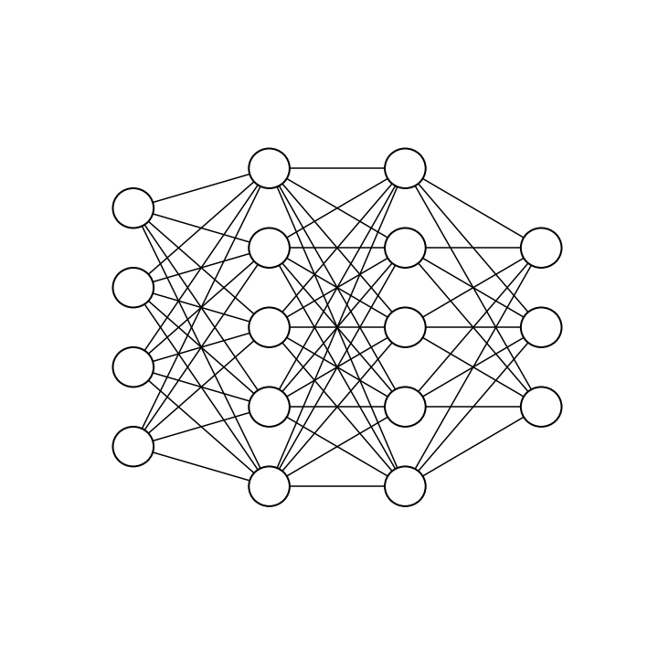

Multilayer perceptron (MLP) / Dense network
Classic feedforward neural network
Densely connected: all inputs from the previous layer connected
In PyTorch: torch.nn.Linear(in_features, out_features) torch.nn.ReLU() or torch.nn.Sigmoid() or …
cat
dog
fish

Slide 18
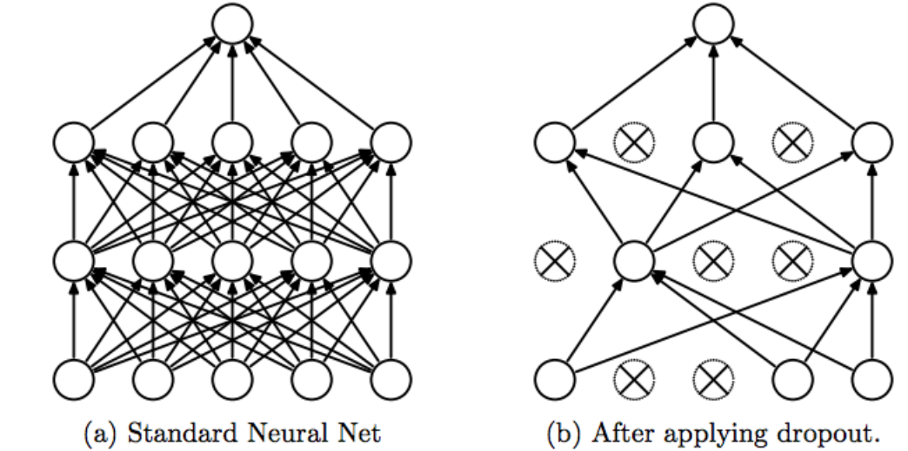
Dropout
Randomly setting a fraction rate of input units to 0 at each update during training
Helps to prevent overfitting (regularization)
In PyTorch: torch.nn.Dropout(p=0.5)
Image from Srivastava et al (2014), JMLR 15: 1929-1958

Slide 19
Flatten
Flatten
flattens the input into a vector
needed if the input is has more than one dimension (2D, 3D, … ), e.g., image data
Example: 1 2 3
4 5 6 → 1 2 3 4 5 6 7 8 9
7 8 9
In PyTorch torch.nn.Flatten()

Slide 20
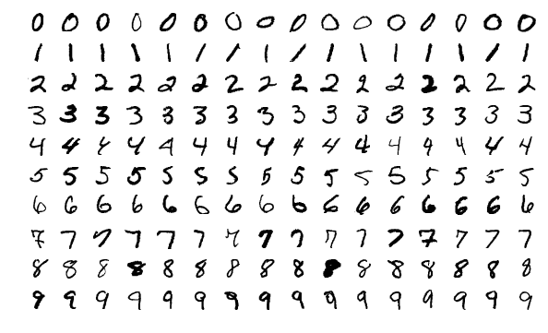
Exercise 2: MNIST - handwritten digits
MNIST database of 70,000 images of handwritten digits
Ten classes: “0”, “1”, …, “9”
28x28 pixel gray scale images
“Hello, world” of machine learning
Task: given a 28x28 image, train an MLP to output the number it represents
Input: x = the 28x28 image (expressed as a matrix of pixel values) Output: y = the correct class (expressed in one-hot-encoding)
0
1
2
3
...
9
[0, 0, 0, 1, 0, 0, 0, 0, 0, 0]

